Slide 1
Business Essentials
Ebert, Griffin, Starke, Dracopoulos
8th Canadian Edition

Slide 2
CHAPTER 13
Pricing, Promoting, and Distributing Products

Slide 3

Learning Objectives
Identify the various pricing objectives that govern pricing decisions and describe the price-setting tools used in making these decisions.
Discuss pricing strategies that can be used for different competitive situations and identify the pricing tactics that can be used for setting prices.
Identify the important objectives of promotion and discuss the considerations involved in selecting a promotional mix.
Discuss the most important advertising strategies and describe the key advertising media.
Notes:
These learning objectives are based upon those at the beginning of the chapter. For a review of learning objectives, see the summary at the end of the chapter, as well as the list of key terms.

Slide 4
Learning Objectives
Outline the tasks involved in personal selling, describe the various types of sales promotions, and distinguish between publicity and public relations.
Explain the meaning of the distribution mix and identify the different channels of distribution.
Describe the role of intermediaries. Explain the functions of wholesalers and identify the types of retailers and
e-intermediaries.
Describe the major activities in the physical distribution process.
Notes:
These learning objectives are based upon those at the beginning of the chapter. For a review of learning objectives, see the summary at the end of the chapter, as well as the list of key terms.

Slide 5
Pricing Objectives and Tools
(LO 13-1)
Pricing to Meet Business Objectives
Profit-maximizing
  pricing to maximize profit (bottom line)
  may sacrifice unit sales to maximize profit
Market-share
  pricing to gain the greatest possible market percentage
Notes:
4
4
Learning Objective: 13-1
Page(s): 319
Notes
Profit maximization will result in lower prices if that is sufficient to make a profit and if it will sell enough units to be it worthwhile. Similarly, market-share pricing could be high if the company is selling a luxury item, such as fur coats. The nature of the pricing objective does not automatically force prices up or down. Rather the pricing objective is what the firm is trying to achieve through its pricing strategy. The level of the price which is needed to achieve its objectives is affected by many other factors.
E-business prices are often lower due to direct marketing and the ability to avoid costs of using intermediaries.
Other issues affecting prices include the need to survive through the tough times, and social and ethical concerns. In such cases, the profit-maximization or market-share objectives may not be feasible.

Slide 6
Pricing Objectives and Tools
(LO 13-1)
Price-Setting Tools
Cost-oriented pricing
  considers the cost of the product and adds a “markup” to arrive at a final cost
    a light bulb costs $0.45 to the retailer
    the retailer sells it for $0.75 (a markup of $0.30)
Markup/Sales Price
Markup Percentage
x 100
Notes:
7
7
Learning Objective: 13-1
Page(s): 319-320

Slide 7
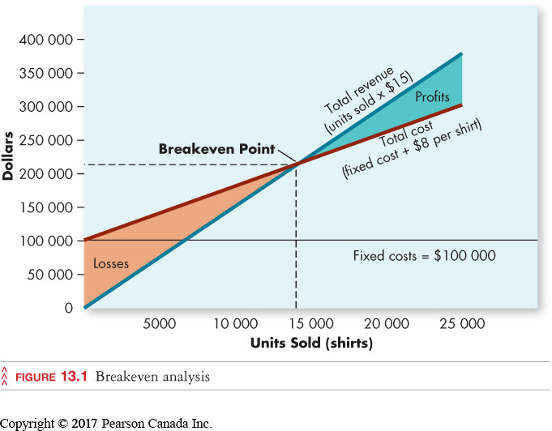
Pricing Objectives and Tools
(LO 13-1)
Break-Even Analysis: Cost–Volume–Profit Relationships
Notes:
8
8
Learning Objective: 13-1
Page(s): 320
Figure 13.1
Notes
Variable costs: costs that change with the number of goods or services produced or sold.
Fixed costs: costs that are unaffected by the number of goods or services produced or sold
Break-even analysis: required to determine how many units must be sold before all fixed costs are covered
Break-even point: how many units a firm must sell in order to cover fixed and variable costs

Slide 8
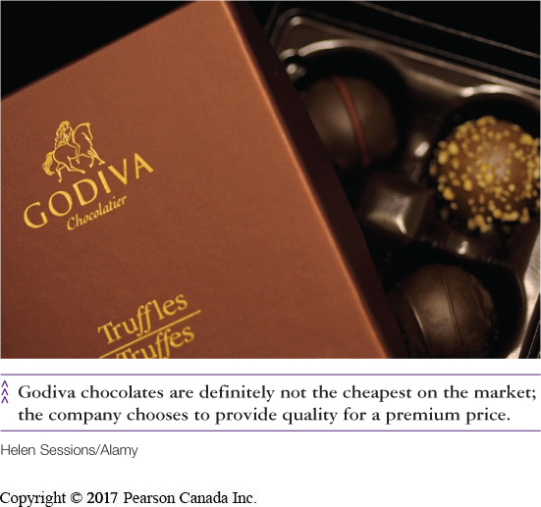
Pricing Strategies and Tactics
(LO 13-2)
Pricing Strategy
  the pricing plan based on the marketing mix
Pricing Existing Products
above, below, or near market prices
Fixed vs. Dynamic Pricing for Online Business
Pricing New Products
skim vs. penetration
Notes:
10
10
Learning Objective: 13-2
Page(s): 321
Notes:
PRICE SKIMMING: Setting an initially high price to cover new product costs and generate a profit.
PENETRATION PRICING: Setting an initially low price to establish a new product in the market.

Slide 9
Pricing Strategies and Tactics
(LO 13-2)
Pricing Tactics
Price lining
Psychological pricing
  Odd–even pricing
Discounting
  price reduction offered as an incentive to purchase
Notes:
13
13
Learning Objective: 13-2
Page(s): 322
Notes
Pricing tactics are the methods used to set prices regardless of which pricing objective is being used by the firm. For example, price lining can be used when a firm prices at or below competition, or uses price skimming or penetrating.
Discounting includes:
Cash discount-customers get a lower price for paying cash
Seasonal discount-lower prices in the off-season to move stock
Trade discount-lower price granted to intermediaries who need to mark up the product for resale (retailers, wholesalers)
Quantity discount-lower prices for buying more units

Slide 10
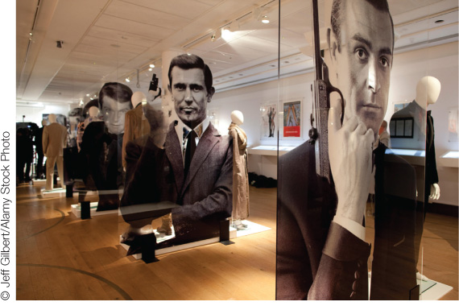
Promoting Products and Services
(LO 13-3)
Promotion
  techniques to communicate information about products (help sales). Key objectives:
    increase product awareness & knowledge
    increase product preference
    help position products and add value
    help control/stabilize sales volume
Notes:
32
32
32
Learning Objective: 13-3
Page(s): 322-323
Notes
Objectives regarding product awareness also include positioning the product in the minds of consumers. Promotion must convey an image of the product which allows consumers to position it relative to other products on the market with regards to price, quality, and features.

Slide 11
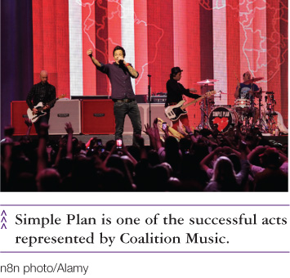
Promoting Products and Services
(LO 13-3)
Promotion Strategies
Push strategy
  firm promotes aggressively to intermediaries
Pull strategy
  firm promotes directly to consumers, who demand the product from intermediaries
Many firms use a combination of both strategies
Notes:
34
34
34
Learning Objective: 13-3
Page(s): 322-323

Slide 12
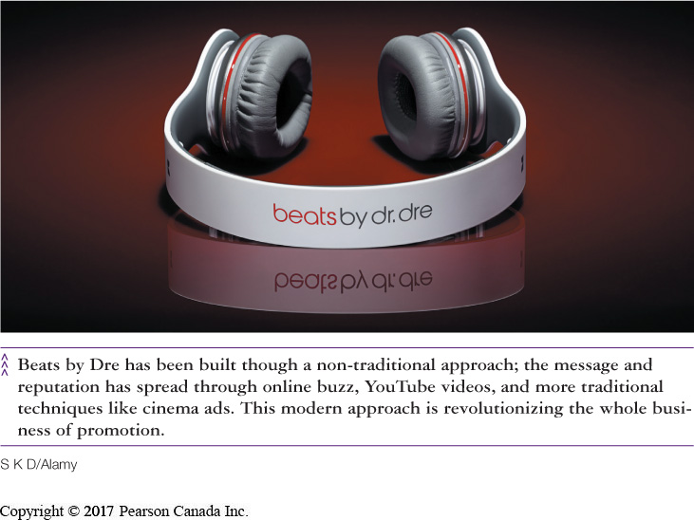
Promoting Products and Services
(LO 13-3)
sales promotions
personal selling
publicity
advertising
Promotional Mix
public relations
Notes:
35
35
35
Learning Objective: 13-3
Page(s): 322-323
Notes
The different promotional methods have different costs. Personal selling is very expensive per contact and is used more frequently with higher priced products or services, or in the industrial market. Advertising is expensive overall but reaches a large group of people at a single time. This makes it appropriate for most consumer products that have a broad market, as well as new products with an information-based ad appeal.

Slide 13
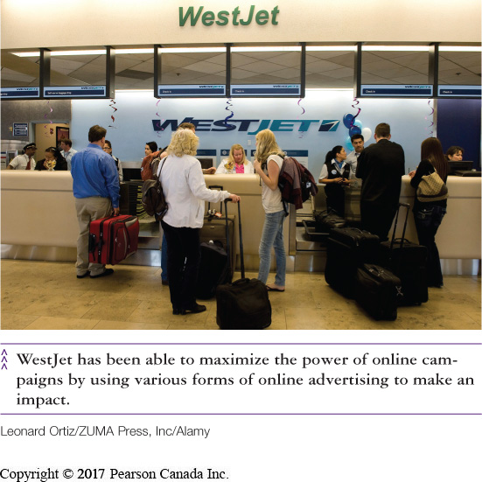
Advertising Promotions
(LO 13-4)
mobile
Internet
television
Media Mix
word-of-mouth
radio
newspapers
outdoor
direct mail
magazines
Notes:
Learning Objective: 13-4
Page(s): 323-326
Notes
The media mix is the combination of media through which a firm chooses to advertise its products. The media to be used in the mix are listed on this slide. Apart from “other media” (a miscellaneous category containing Yellow Pages, skywriting, telephone calls, special events and door-to-door communications).

Slide 14
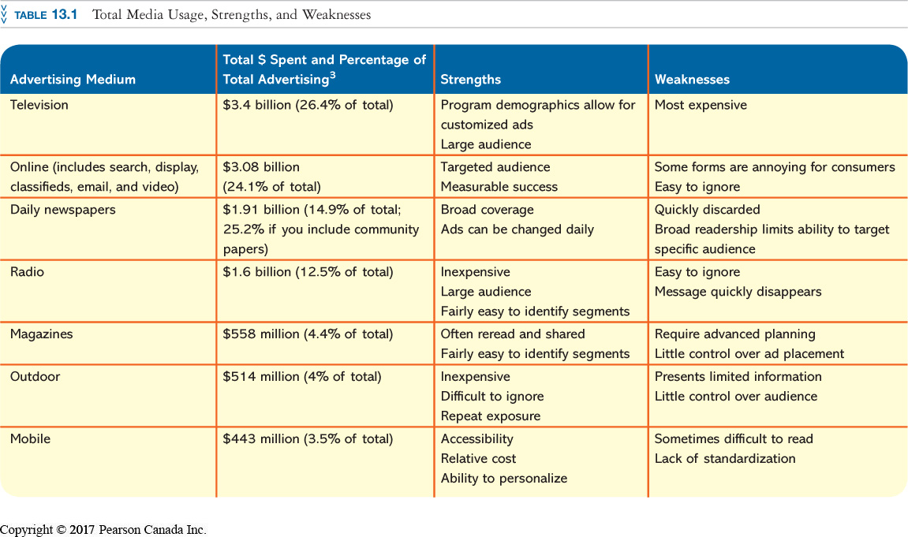
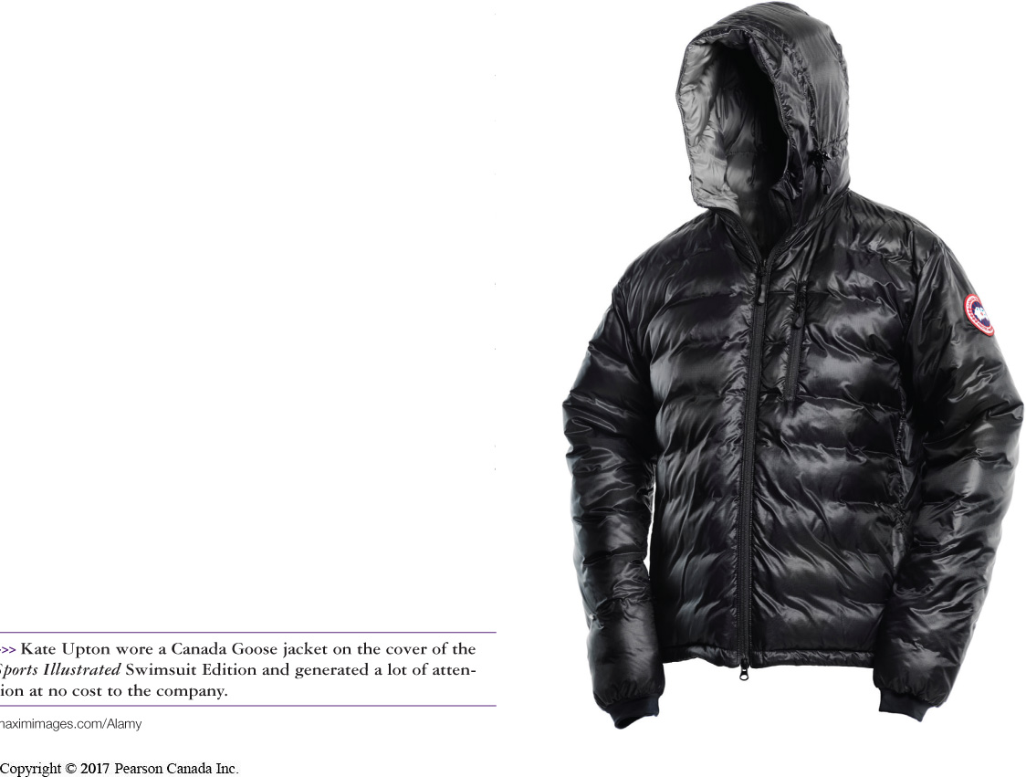
Advertising Promotions
(LO 13-4)
Notes:
Learning Objective: 13-4
Page(s): 323-326
Table 13.1

Slide 15

Advertising Promotions
(LO 13-4)
The Internet and Consumer Engagement
Companies are encouraging consumers to get involved and influence marketing decisions.
  Starbucks
    name a flavour
  Crayola
    new colour ideas
  Frito Lay
    new flavour ideas and ad themes
Notes:
Learning Objective: 13-4
Page(s): 323-326

Slide 16
Personal Selling
(LO 13-5)
Personal Selling
  the most expensive form of promotion per contact
  involves personal interaction
  telemarketing is becoming more popular due to lower cost
Sales Promotions
  short-term promotional activities designed to stimulate buying or cooperation from distributors
Coupons
Point-of-purchase (POP) displays
Purchase incentives/ premiums
Trade shows
Contests and sweepstakes
Notes:
53
53
53
Learning Objective: 13-5
Page(s): 326-328

Slide 17
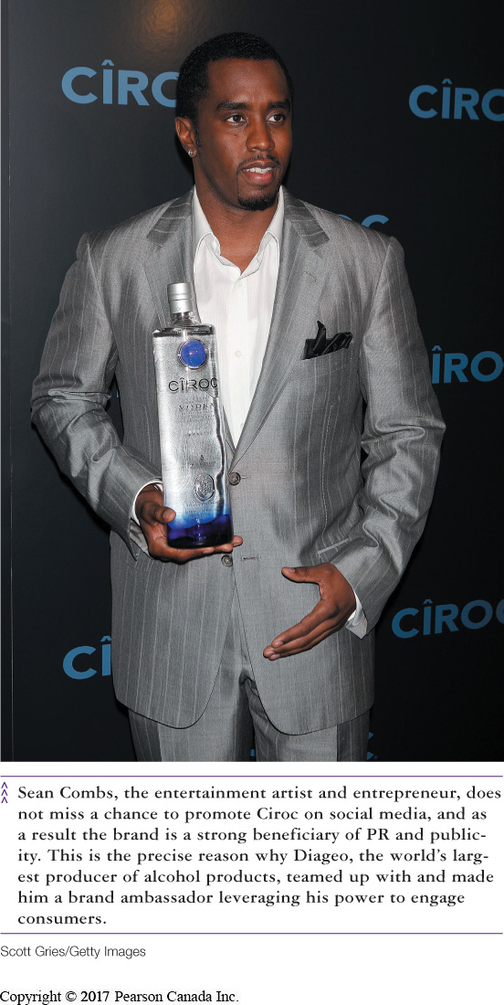
Publicity and Public Relations
(LO 13-5)
Publicity
  information made available to consumers via media outlets
  free, but the company has no control over it
Public Relations
  company-influenced information aimed at building goodwill or dealing with an unfavourable event
    public service announcements
Notes:
56
56
56
Learning Objective: 13-5
Page(s): 326-328

Slide 18
The Distribution Mix
(LO 13-6)
The combination of distribution channels used to get products to end-users
Intermediary
  an entity other than the producer who distributes the product
Wholesaler
  an intermediary who sells products to other businesses for resale
Retailer
  an intermediary who sells products directly to consumers
Notes:
17
17
Learning Objective: 13-6
Page(s): 328-330
Notes
The use of intermediaries can make a channel more efficient. Intermediaries are specialists in offering the services they offer. As such, a longer channel of distribution does not necessarily increase prices to end-users. If the intermediary was eliminated, all distribution tasks would still have to be performed, and many would be performed less efficiently, eliminated the cost-savings of a shorter distribution channel.

Slide 19
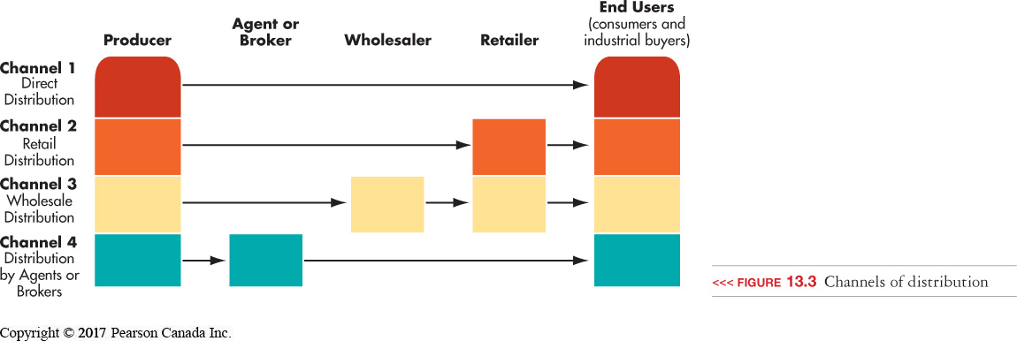
The Distribution Mix
(LO 13-6)
Distribution channel
  the path a product follows to the end user
Notes:
Learning Objective: 13-6
Page(s): 328-330

Slide 20
The Distribution Mix
(LO 13-6)
Sales Agent
Broker
independent intermediary
deals in related product lines of a few producers
forms long-term relationships
independent intermediary
matches numerous sellers and buyers as needed
Notes:
23
23
Learning Objective: 13-6
Page(s): 328-330

Slide 21
The Distribution Mix
(LO 13-6)
Distribution Strategies
Intensive
  use as many channels and members as possible
Selective
  use of a limited number of outlets
Exclusive
  use of only one intermediary in a market area
Channel Conflict
  when members of a distribution channel disagree over the roles they should play and/or the rewards they should receive
Notes:
19
19
Learning Objective: 13-6
Page(s): 328-330
Notes
The type of product dictates how accessible the product must be to customers.

Slide 22
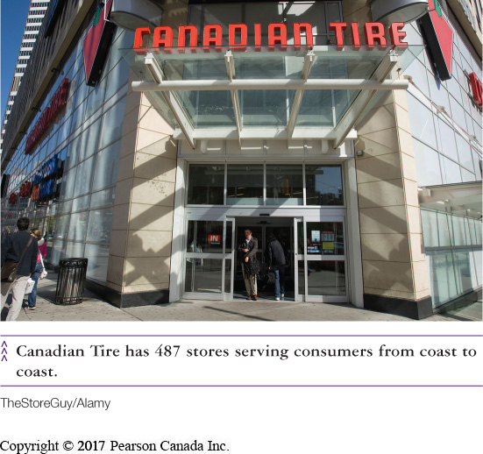
Retailing
(LO 13-7)
Types of Retail Outlets
Product Line Retailers
  Department stores
  Supermarkets
  Specialty stores
  Category killers
Bargain Retailers
  Discount houses
  Factory outlets
  Wholesale clubs
Convenience Stores
Notes:
Learning Objective: 13-7
Page(s): 330-332

Slide 23
Retailing
(LO 13-7)
Non-Store Retailing
Direct-Response
  Mail-Order
  Telemarketing
  Direct Selling
  Video/TV
Notes:
Learning Objective: 13-7
Page(s): 330-332

Slide 24
Retailing
(LO 13-7)
E-intermediaries
  internet-based channel members who perform one or both of two functions:
    collect information about sellers and present it to consumers
    2) they help deliver internet products to buyers
Notes:
Learning Objective: 13-7
Page(s): 330-332

Slide 25

Physical Distribution
(LO 13-8)
Physical Distribution
  activities needed to move a product efficiently from manufacturer to consumer
Warehousing Operations
  the storing of goods through the distribution process
Notes:
42
42
Learning Objective: 13-8
Page(s): 333

Slide 26
Physical Distribution
(LO 13-8)
Transportation Modes
Trucks
Planes
Digital Transmission
Railroads
Water carriers
Pipelines
Notes:
Learning Objective: 13-8
Page(s): 333

Slide 27
Physical Distribution
(LO 13-8)
Distribution as a Marketing Strategy
    increasingly important tool to gain a competitive advantage
    companies that have leveraged distribution advantages include
Walmart
Zara
Dell
Notes:
44
44
Learning Objective: 13-8
Page(s): 333

Slide 28
QUICK-CHECK QUESTIONS
1) ________ provides an assessment of how many units must be sold at a given price before the company begins to make a profit.
A) Cost-benefit analysis
B) Competitive pricing analysis
C) Cost-based pricing analysis
D) Break-even analysis
Answer:
D) Break-even analysis

Slide 29
QUICK-CHECK QUESTIONS
2) Lays Chips is about to introduce a new brand of low fat, low-sodium potato chips to the market. They wish to ensure as many customers try them as possible. What pricing strategy should they use?
A) price skimming
B) price lining
C) market price
D) penetration pricing
Answer:
D) penetration pricing

Slide 30
QUICK-CHECK QUESTIONS
3) Many pay-per-view events advertise on free television and ask interested viewers to “contact their cable provider”. This is an example of a ___________.
A) pull strategy
B) push strategy
C) promotional mix
D) direct marketing strategy
Answer:
A) pull strategy

Slide 31
QUICK-CHECK QUESTIONS
4) When products are expensive and complicated, the most effective promotional tool is likely ____________.
A) publicity
B) infomercials
C) magazine advertising
D) personal selling
Answer:
D) personal selling

Slide 32
QUICK-CHECK QUESTIONS
5) Rolex watches uses _______ distribution, while Coca Cola uses a(n) ________ distribution strategy.
A) exclusive; intensive
B) intensive; exclusive
C) selective; intensive
D) intensive; selective
Answer:
A) exclusive; intensive

